Slide 1
Paradox Billiards
By Dark SOLZ
Mat Schweigardt, Mark Obeldobel, Daniel Lowery, Luke Zetterlund

Slide 2
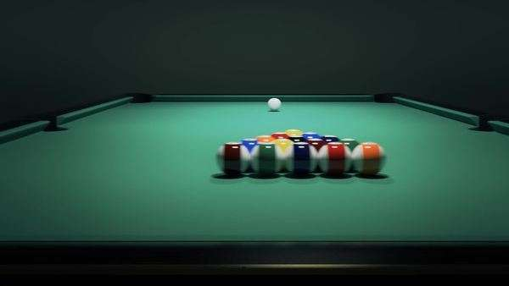
Reminder
-Billiards Board
-Physics
-Simulation

Slide 3
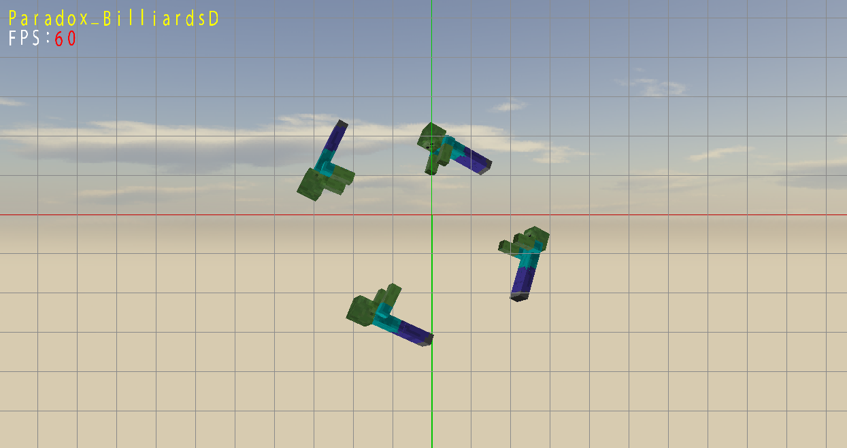
Where We Are
-Synchronized Swimming Zombies
-Feels clean, but not as much progress as we’d hoped.

Slide 4
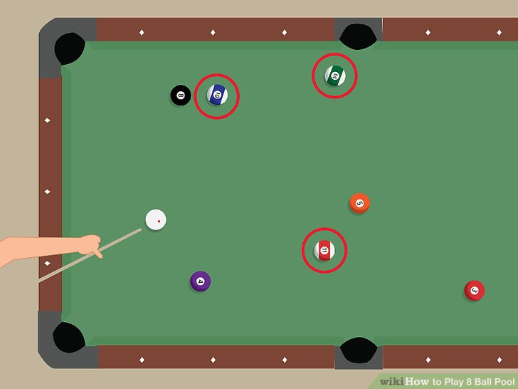
So What Now?
-Well, a lot! -Set the scene: lighting, skybox, models -Add much more user functionality -Start on ball physics

